Slide 1

Front Page Added as per Task 5
Added

Slide 2
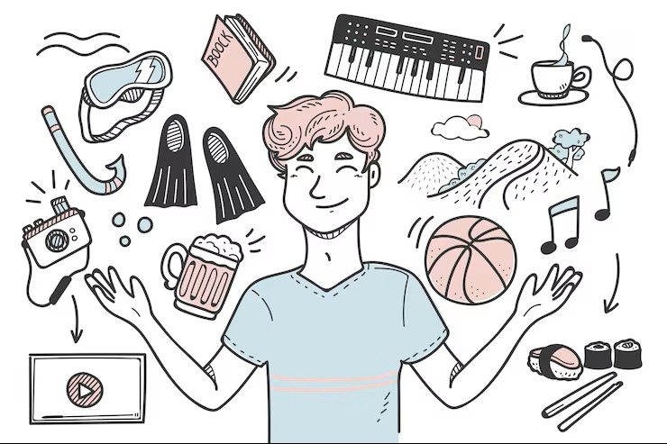
My Favourite Hobbies
Notes:
Welcome everyone! Today I'm going to share a glimpse into my personal world by walking you through some of my favourite hobbies that keep me inspired and energized.

Slide 3

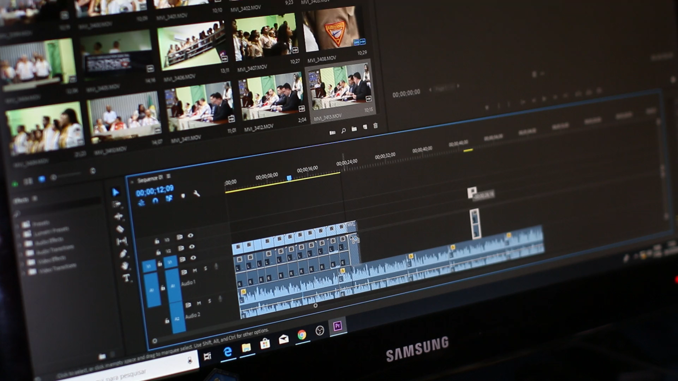
Video Editing
Video editing is the process of arranging video clips to create a better, more understandable video for the viewer.
It involves using cuts, transitions, and special effects, along with adjusting color saturation.
For professional video editing, software like Premiere Pro is typically used,
Whereas CapCut is a popular option for general video editing tasks.
Import & Arrange Clips
Sound Editing
Final Export Video
Add Transition & Effects
Steps Of Video Editing
Notes:
Next, let's dive into my creative passion: video editing. I'll explain how arranging clips and using transitions helps tell a clearer story, and briefly mention the software tools I prefer to use.

Slide 4
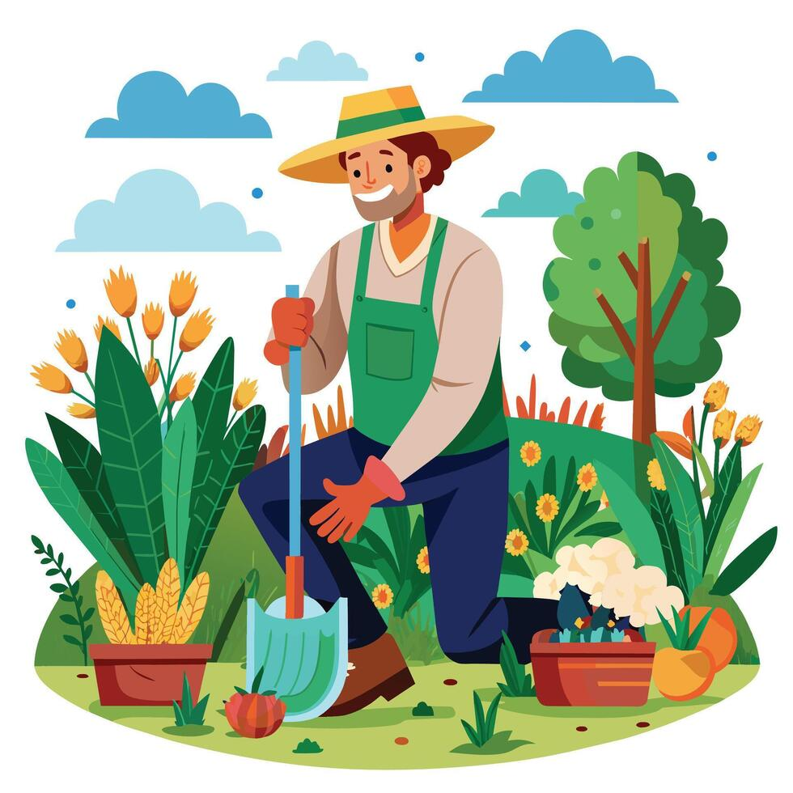
Gardening
Utilizing essential gardening tools like pruners, spades, and a watering system allows me to nurture my vibrant sanctuary and feel a deep connection to nature.
Prepare the Soil
Plant Seed or Saplings
Water & Nurture
Monitor Growth
Notes:
Gardening" slide, you could create notes saying: "Finally, I'll talk about my love for gardening. I'll mention the essential tools I use, like pruners and spades, and how nurturing my plants helps me feel connected to nature.

Slide 5
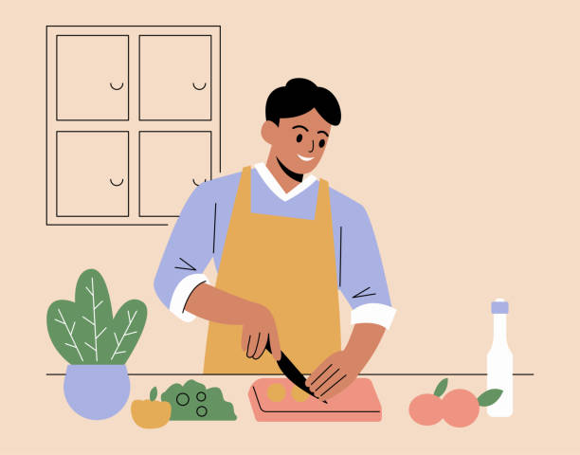
Cooking
"Experimenting with diverse ingredients and flavors allows me to express my creativity and turn simple recipes into delicious meals to share with my family and friends."
Source Ingredients
Prepare Ingredients
Cook the Dish
Serve & Enjoy
Steps of Cooking
Notes:
Now, let's explore my journey in the kitchen. I'll share how experimenting with different ingredients lets me be creative and whip up delicious meals for the people I care about.

